Slide 1
Distributed Microservice Health Monitoring System
23CSE312 Distributed System
Team_No: 9
S.No | Reg.No | Name of the Student | Section
1 | BL.EN.U4CSE23141 | P.Pavitra Kumari | CSE B
2 | BL.EN.U4CSE23130 | K.L.Anvitha | CSE B
3 | BL.EN.U4CSE23132 | M.Sai Meghana | CSE B

Slide 2
Problem Definition
Modern distributed systems consist of multiple microservices that must be continuously monitored for performance and reliability.
Traditional centralized monitoring systems create a single point of failure and lack scalability.
This project proposes a distributed health monitoring system where multiple services are monitored in real-time using a central and backup monitoring mechanism.
The system ensures fault tolerance, high availability, and real-time alert generation for system anomalies.

Slide 3
Literature Survey
S.No | Author Name(s) | Full title of the paper with year | Inference from the paper (methodology, technology) | Open problem (for your proposed work)
1 | S. Newman | Building Microservices (2022) | This paper explains microservices architecture, focusing on scalability, independent deployment, and modular system design for distributed applications. | Managing communication overhead and coordination between multiple distributed services remains a challenge.
2 | M. Villamizar et al. | Evaluating Monolithic vs Microservices Architecture (2022) | This study compares monolithic and microservices architectures in terms of performance, scalability, and flexibility in distributed systems. | Achieving efficient monitoring and coordination in large-scale microservices environments is still difficult. .

Slide 4
Literature Survey
S.No | Author Name(s) | Full title of the paper with year | Inference from the paper (methodology, technology) | Open problem (for your proposed work)
3 | N. Dragoni et al. | Microservices: Yesterday, Today, Tomorrow (2022) | This paper provides an overview of microservices evolution and highlights their role in distributed system design. | Ensuring reliability and fault tolerance in highly dynamic distributed environments remains a challenge.
4 | R. Taibi et al. | Migration to Microservices Architecture (2023) | This research discusses challenges and methodologies involved in migrating from monolithic to microservices systems. | Handling failures and maintaining system stability during migration is still an open issue.

Slide 5
Literature Survey
S.No | Author Name(s) | Full title of the paper with year | Inference from the paper (methodology, technology) | Open problem (for your proposed work)
5 | L. Chen | Microservices and DevOps Architecture (2023) | This paper focuses on continuous integration, deployment, and monitoring techniques used in microservices-based systems. | Real-time monitoring and efficient alert generation remain challenging problems.
6 | J. Thönes | Microservices Design Principles (2023) | This work describes design principles and patterns for building scalable and maintainable distributed systems. | Reducing latency and improving communication efficiency between services is an open problem.

Slide 6
Literature Survey
S.No | Author Name(s) | Full title of the paper with year | Inference from the paper (methodology, technology) | Open problem (for your proposed work)
7 | A. Balalaie et al. | Microservices and Cloud-Native Systems (2024) | This paper explains cloud-native architectures and their integration with DevOps practices for scalable systems. | Ensuring system reliability and performance under high workload conditions remains a challenge.
8 | Y. Gan et al. | Benchmarking Distributed Systems (2024) | This study provides benchmarking techniques and tools to evaluate performance in microservices architectures. | Improving real-time monitoring accuracy and efficiency is an open research problem..

Slide 7
Literature Survey
S.No | Author Name(s) | Full title of the paper with year | Inference from the paper (methodology, technology) | Open problem (for your proposed work)
9 | B. Burns et al. | Designing Distributed Systems (2025) | This work describes scalable system design patterns and monitoring techniques used in distributed environments. | Handling automatic recovery from system failures remains a key challenge.
10 | M. Richards and N. Ford | Fundamentals of Software Architecture (2025) | This paper discusses best practices for designing scalable and reliable distributed systems. | Developing fully autonomous monitoring and fault detection systems is still an open problem..

Slide 8
Software/Tools Requirements
• Programming Language: Python 3
• Framework: Flask (for building monitoring APIs)
• Libraries Used:
- psutil (for CPU and memory monitoring)
- requests (for inter-service communication)
• Development Environment:
- Visual Studio Code
• Frontend Technologies:
- HTML, CSS (for dashboard UI)
• Communication Protocol:
- HTTP (for data exchange between services)
• Platform:
- Windows OS
• Browser:
- Google Chrome (for dashboard visualization)

Slide 9
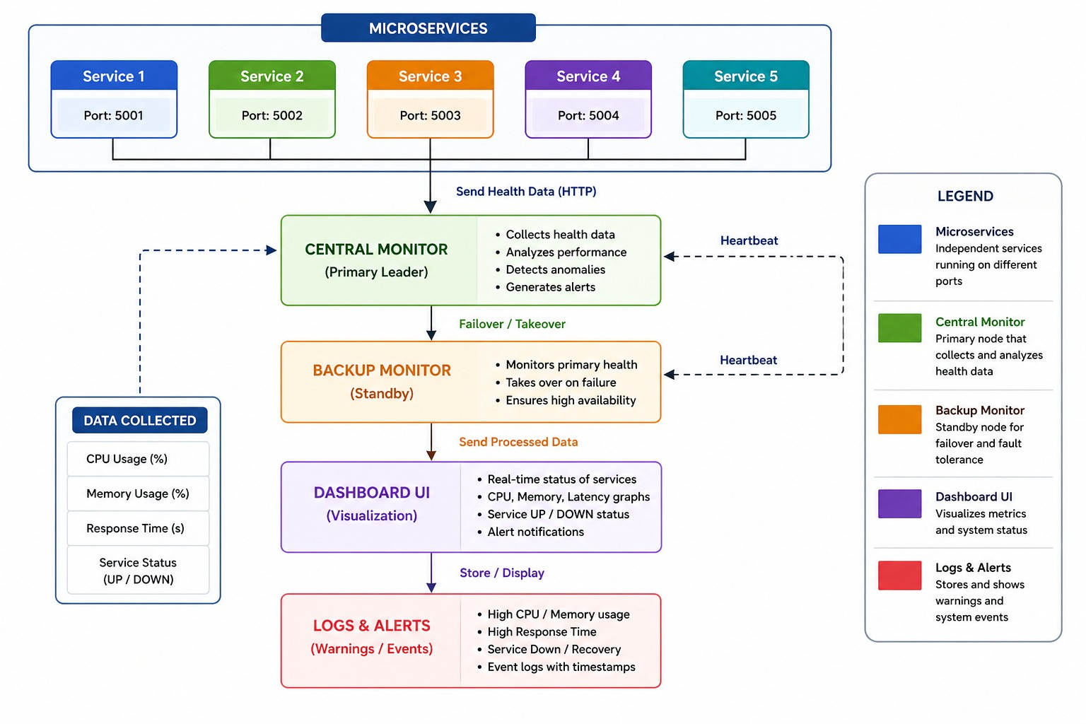
Architecture / Design

Slide 10
Implementation – Backend & Monitoring
• Developed using Python and Flask framework
• Each microservice runs independently as a separate process
• System monitoring implemented using psutil library
• Tracks:
- CPU usage
- Memory usage
- Response time
• Central Monitor collects data from all services
• Health check implemented using heartbeat mechanism
• Detects:
- Service failures
- Performance degradation

Slide 11
Implementation – Fault Tolerance & Visualization
• Backup Monitor implemented for fault tolerance
• Automatically takes over if primary monitor fails
• Ensures no single point of failure
• Real-time alert system generates warnings for:
- High CPU usage
- High memory usage
- High response time
• Dashboard built using HTML, CSS, and HTTP server
• Displays:
- Service status (UP/DOWN)
- Performance metrics
- Graphical analysis of system data

Slide 12
Result and Analysis
Monitored 5 independent services in real time
Detected service failure using heartbeat timeout and active health checks
Backup monitor successfully took over after primary failure
Metrics persisted in database and visualized on dashboard
System measured latency, detection time, recovery time, and alert timing

Slide 13
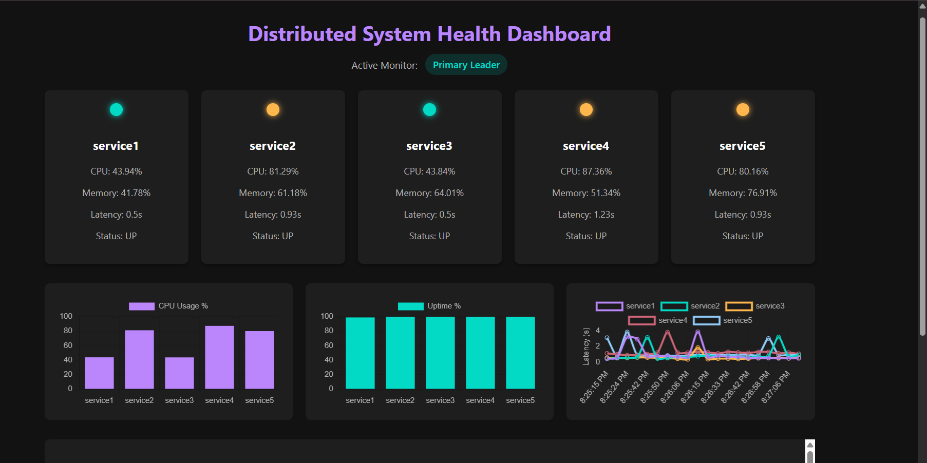
Result and Analysis
• Real-time monitoring of 5 services
• Displays CPU, Memory, Latency
• Shows service status (UP/DOWN)
• Graphical visualization of system performance

Slide 14
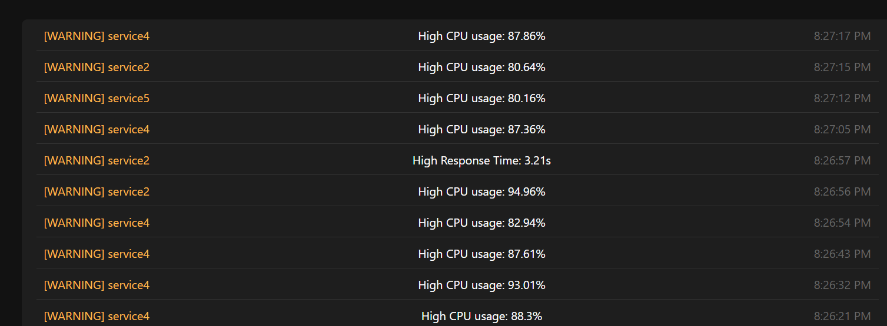
Result and Analysis
• Detects high CPU usage
• Detects high response time
• Generates warning logs
• Helps identify system failures

Slide 15
Future Enhancement
Deploy across multiple machines instead of one local system
Use Raft/consensus-style leader election
Add authentication and secure APIs
Export benchmark reports as CSV/JSON
Deploy with Docker/Kubernetes

Slide 16
Conclusion
Successfully implemented a distributed monitoring system
Achieved fault tolerance using backup monitor
Ensured real-time detection of system issues
Eliminated single point of failure
Demonstrated distributed system behavior effectively

Slide 17
Team Contributions
Meghana:
• Contributed to backend development and monitoring system
• Worked on CPU, memory, and latency tracking
• Assisted in system integration and testing
Pavitra:
• Contributed to frontend dashboard design and development
• Worked on data visualization and UI implementation
• Assisted in integrating frontend with backend services
Anvitha :
• Contributed to service communication and system architecture
• Worked on fault tolerance and backup monitor system
• Assisted in testing and debugging

Slide 18
References
[1] S. Newman, “Building Microservices,” O’Reilly, 2022.
[2] M. Villamizar et al., “Evaluating Monolithic vs Microservices Architecture,” IEEE, 2022.
[3] N. Dragoni et al., “Microservices: Yesterday, Today, Tomorrow,” Springer, 2022.
[4] R. Taibi et al., “Migration to Microservices Architecture,” IEEE, 2023.
[5] L. Chen, “Microservices and DevOps Architecture,” IEEE, 2023.
[6] J. Thönes, “Microservices Design Principles,” IEEE Software, 2023.
[7] A. Balalaie et al., “Microservices and Cloud-Native Systems,” IEEE, 2024.
[8] Y. Gan et al., “Benchmarking Distributed Systems,” ACM, 2024.
[9] B. Burns et al., “Designing Distributed Systems,” O’Reilly, 2025.
[10] M. Richards and N. Ford, “Fundamentals of Software Architecture,” O’Reilly, 2025.

Slide 19
THANK YOU

